Slide 1

STOCK MARKET INVESTMENT STRATEGY
Presenter Name

Slide 2



Agenda
Problem statement
Introduction
Exploratory Data Analysis
Conclusion
Recommendations

Slide 3

What is the best long term investment strategy for a R100,000?

Slide 4


Introduction
S & P 500 giants: Microsoft and Amazon
Cryptocurrency giant: Bitcoin
Inflation rate

Slide 5

EXPLORATORY DATA ANALYSIS

Slide 6
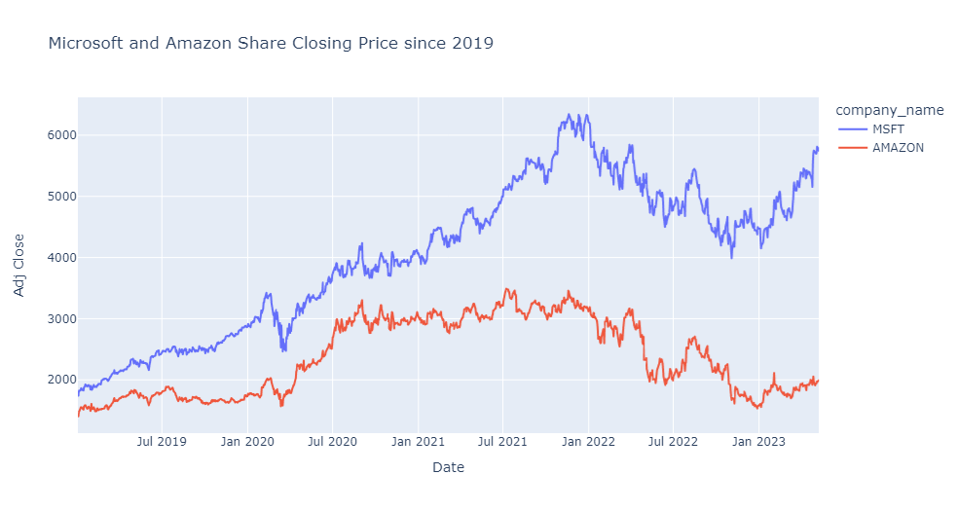
Chart

Slide 7
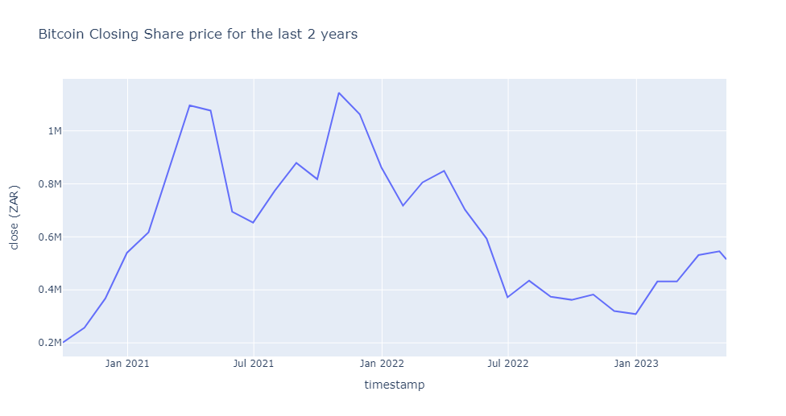
Chart

Slide 8
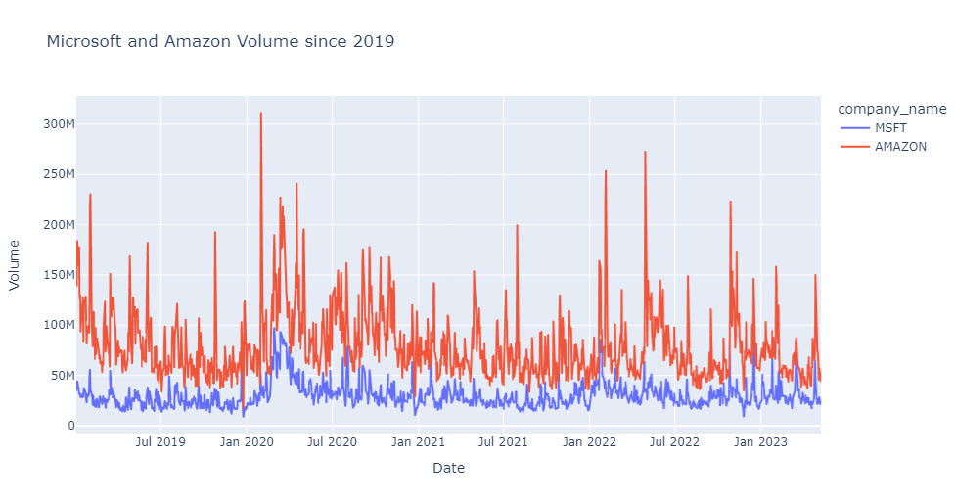
Chart

Slide 9
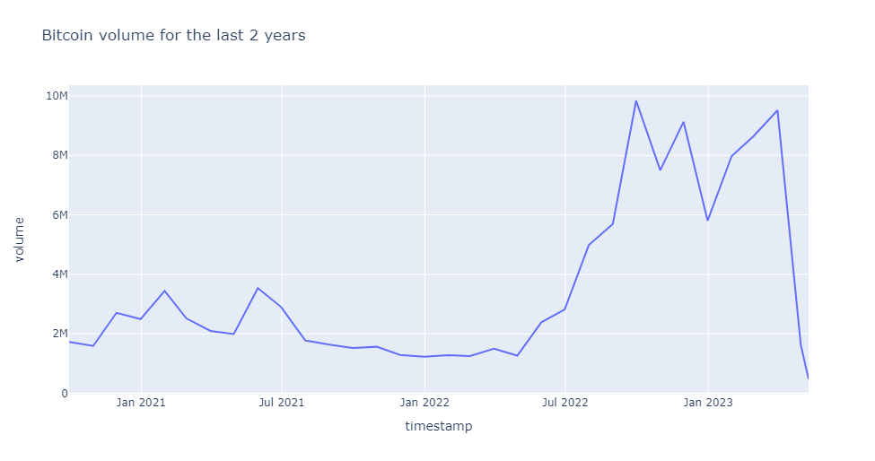
Chart

Slide 10
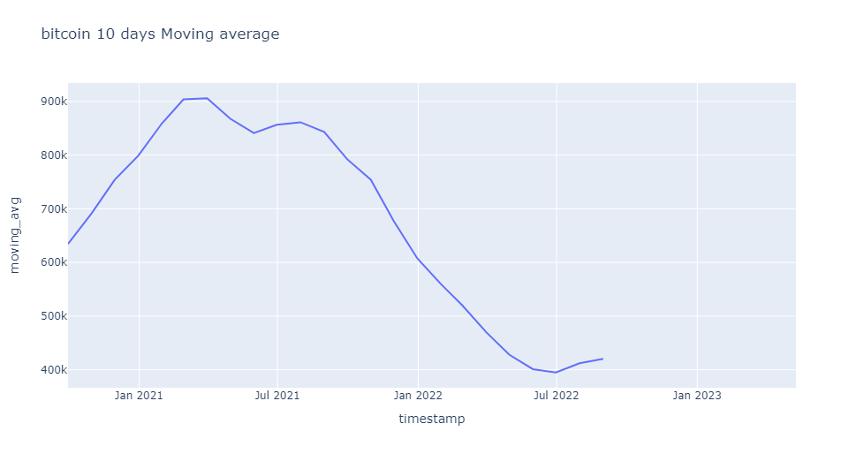
Chart

Slide 11
The way to get started is to quit talking and begin doing.
Walt Disney

Slide 12




Team
Name
Name
Name
Name
Title
Title
Title
Title

Slide 13
Timeline
Title
To start a presentation, go to the Slide Show tab, and select From Beginning.
Title
To display Presenter view, in Slide Show view, on the control bar at the bottom left select the three dots, and then Show Presenter View.
Title
During your presentation, the speaker notes are visible on your monitor, but aren't visible to the audience.
Title
Title
If you don’t see the Notes pane or it is completely minimized, click Notes on the task bar across the bottom of the PowerPoint window.
The Notes pane is a box that appears below each slide. Tap it to add notes.

Slide 14
Content
Subtitle
Subtitle
Add text, images, art, and videos.
Add transitions, animations, and motion.
Save to OneDrive, to get to your presentations from your computer, tablet, or phone.
Open the Design Ideas pane for instant slide makeovers.
When we have design ideas, we’ll show them to you right there.

Slide 15
Content 2
Subtitle
subtitle
subtitle
Add text, images, art, and videos.
Add transitions, animations, and motion.
Save to OneDrive, to get to your presentations from your computer, tablet, or phone.
Open the Design Ideas pane for instant slide makeovers.
When we have design ideas, we’ll show them to you right there.
Add text, images, art, and videos.
Add transitions, animations, and motion.
Save to OneDrive, to get to your presentations from your computer, tablet, or phone.
Open the Design Ideas pane for instant slide makeovers.
When we have design ideas, we’ll show them to you right there.
Add text, images, art, and videos.
Add transitions, animations, and motion.
Save to OneDrive, to get to your presentations from your computer, tablet, or phone.
Open the Design Ideas pane for instant slide makeovers.
When we have design ideas, we’ll show them to you right there.

Slide 16

Summary
With PowerPoint, you can create presentations and share your work with others, wherever they are. Type the text you want here to get started. You can also add images, art, and videos on this template. Save to OneDrive and access your presentations from your computer, tablet, or phone.

Slide 17


Thank You
Presenter name
Email address
Website address

